Slide 1
Basic Guidelines for
Tuesday Night Fun Talks
SWFS Denver 2019
Identification of Forensic Analysts
in the modern
Wildlife Forensic Laboratory
R
Penelope Pittstop, PhD, Chief Scientist, Forensics Us

Slide 2
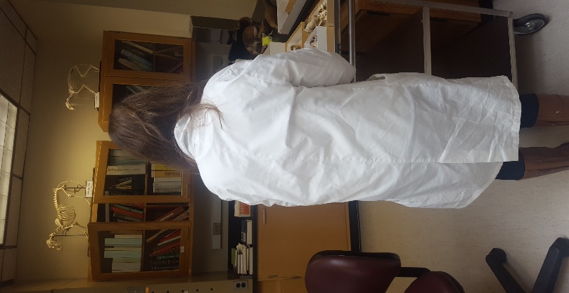
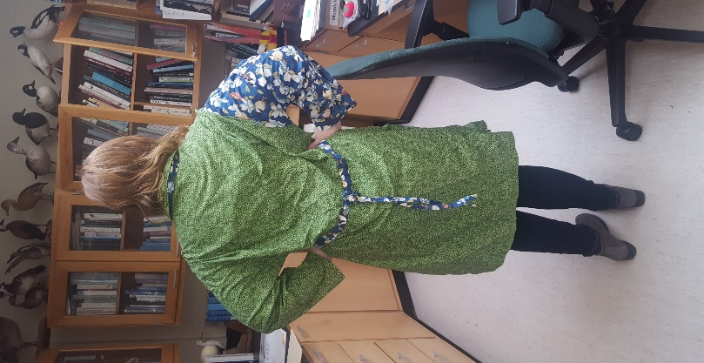
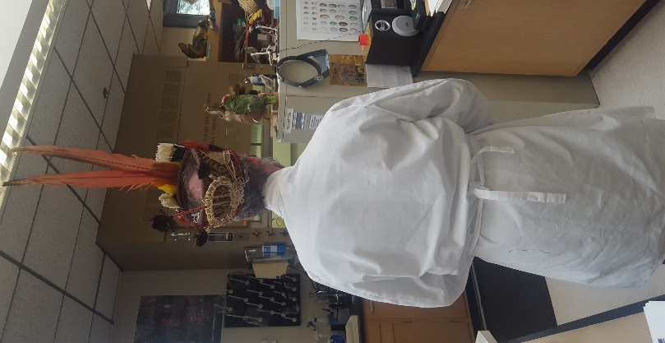
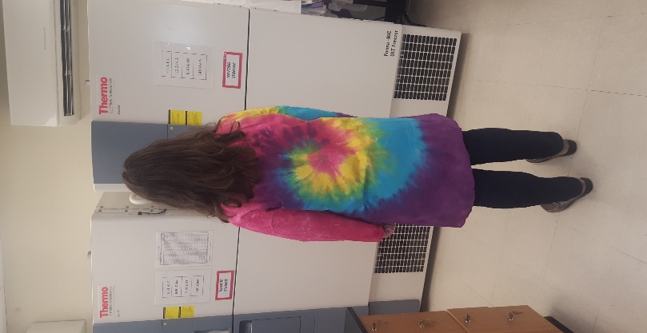
Talks are limited to 10 minutes or less. Less is better.
No more than SIX slides may be used.
Not a forum for scientific presentations
Interesting case studies or funny stories are welcome. Talks may also be pure fiction. Have fun with it.
Classification schemes require characteristics that can be sorted (Class Characteristics)
Common features can be metric or meristic, but sometimes they’re just random
Wildlife Forensic Scientists (WFS) are not often Common Creatures
Limit the use of scientific charts, graphs, and tables.
Use photos
Be creative
Features chosen for the purpose of classifying WFS may be Random and Subjective

Slide 3
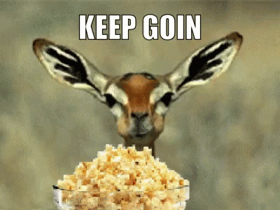
THE DATA:
I don’t really have data. This is just stuff I noticed
after I took some pictures
Table 1: 3 PRIMARY CHARACTERS used in classification of Forensic Scientists:
Coat Color
Hair length
Habitat

Slide 4
Coat Color: NONE ALOT
1
2
3
4
1
2
3
4
Hair Length: MEDIUM LONG ???
2
3
4
1
2
3
4
1

Slide 5
Habitat:
FEATHERS BONES D N A
1
3
2
4

Slide 6
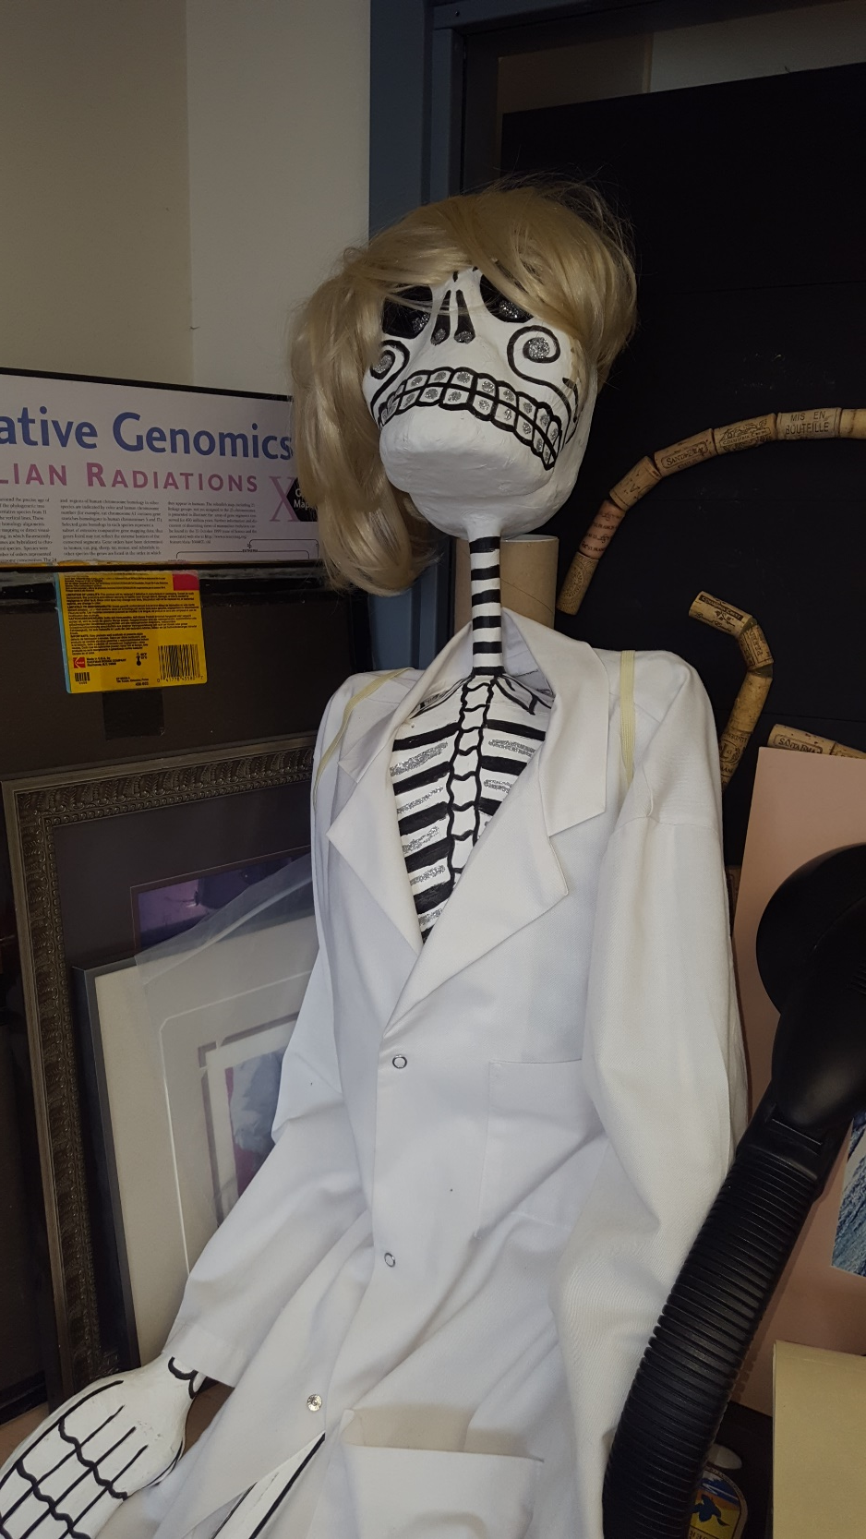
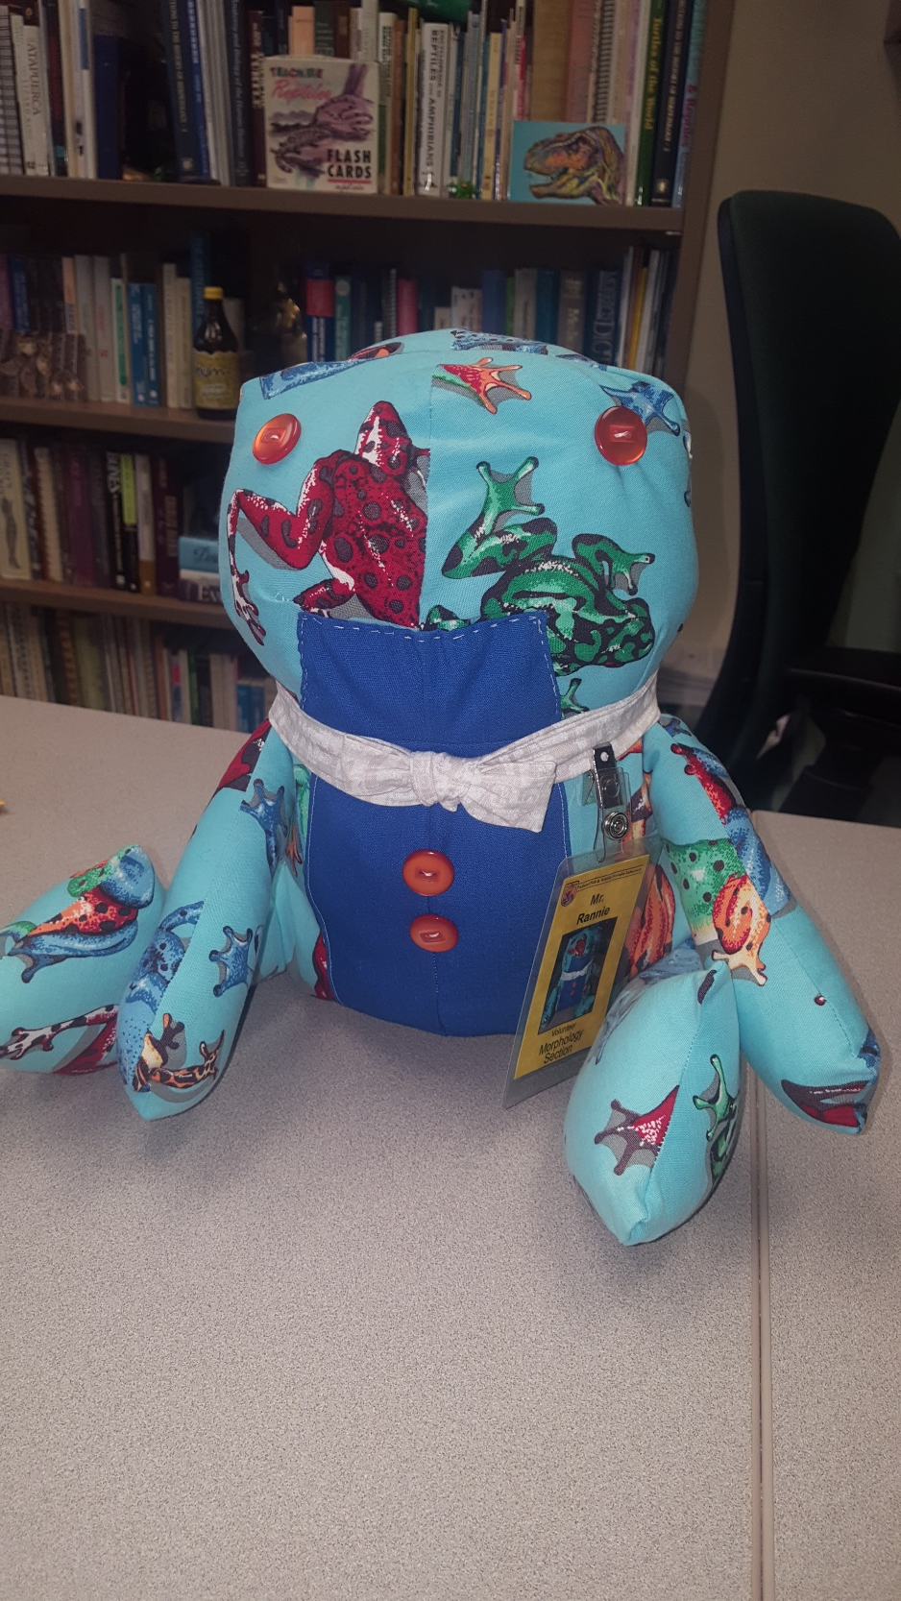
Evidence to support lack of color as pleisiomorphic condition:
Submit your talk using the application from the SWFS website
Deadline for Applications for Tuesday Night Fun Talks is June 4, 2019
Email to Mary_Curtis@fws.gov
Decisions will be made by June 9
Authors will be notified at Registration
All talks are at the Butterfly Garden venue on Tuesday June 11, 6:30 pm
Presentations will follow a Keynote Speaker

